Slide 1
Singapore Hotel Reviews
Bharat Nagaraju (A0178258N)
Chan Su-Wen Philemon (A0110588E)
Guo Lei (A0059762U)
Vigneshram Selvaraj (A0178215A)
MTECH Knowledge Engineering (Part-Time)

Slide 2

OBJECTIVES
Use Trip Advisor and Yelp reviews of 6 hotels to
Understand
Identify
Recommend
Reviewers’ Profile
Most Preferred Hotel(s)
Business Strategies
Notes:
clear theme (poverty)
breaking down large points into smaller points to extract more stories
highlighting interesting individual data points
story evolves with suspense and climactic moments

Slide 3


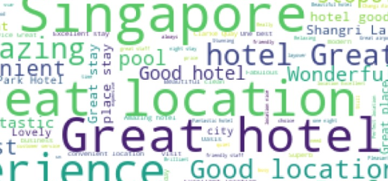




Technical Approach
EDA Using Aggregation Pipeline
Notes:
In the Ministry of Social and Family Development's (MSF) last financial year, which ended in March 2017,
28,409 households were on the short to medium term assistance scheme, HH income less than $1900,
The Community Care Endowment Fund (ComCare Fund) is one of the key social safety nets for poor families
and most of the households receiving Comcare help are on the short to medium term assistance scheme.

Slide 4
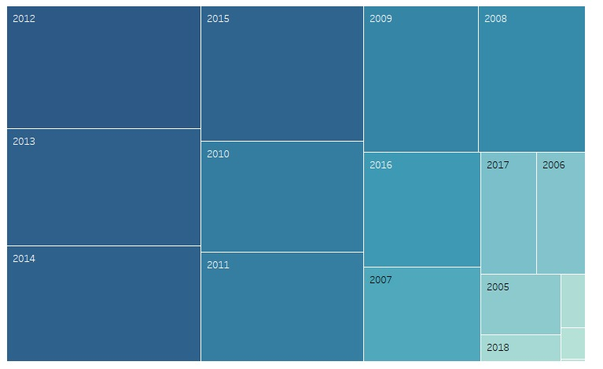
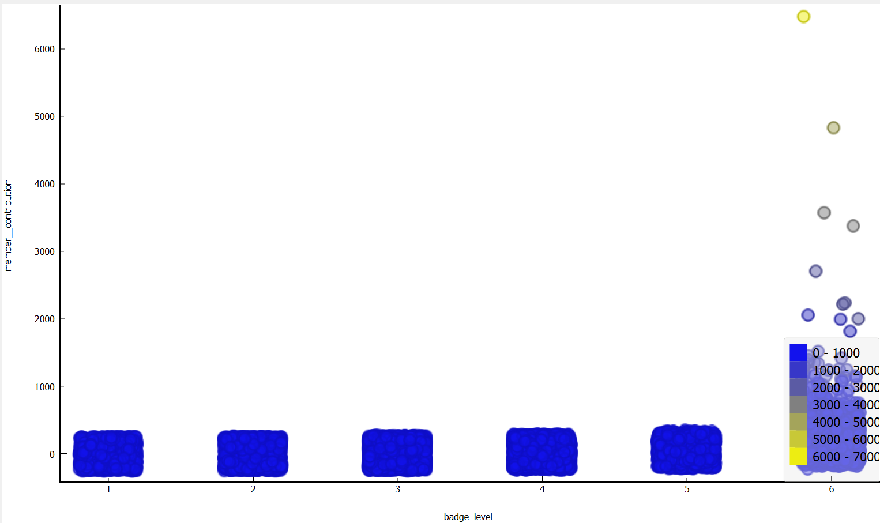
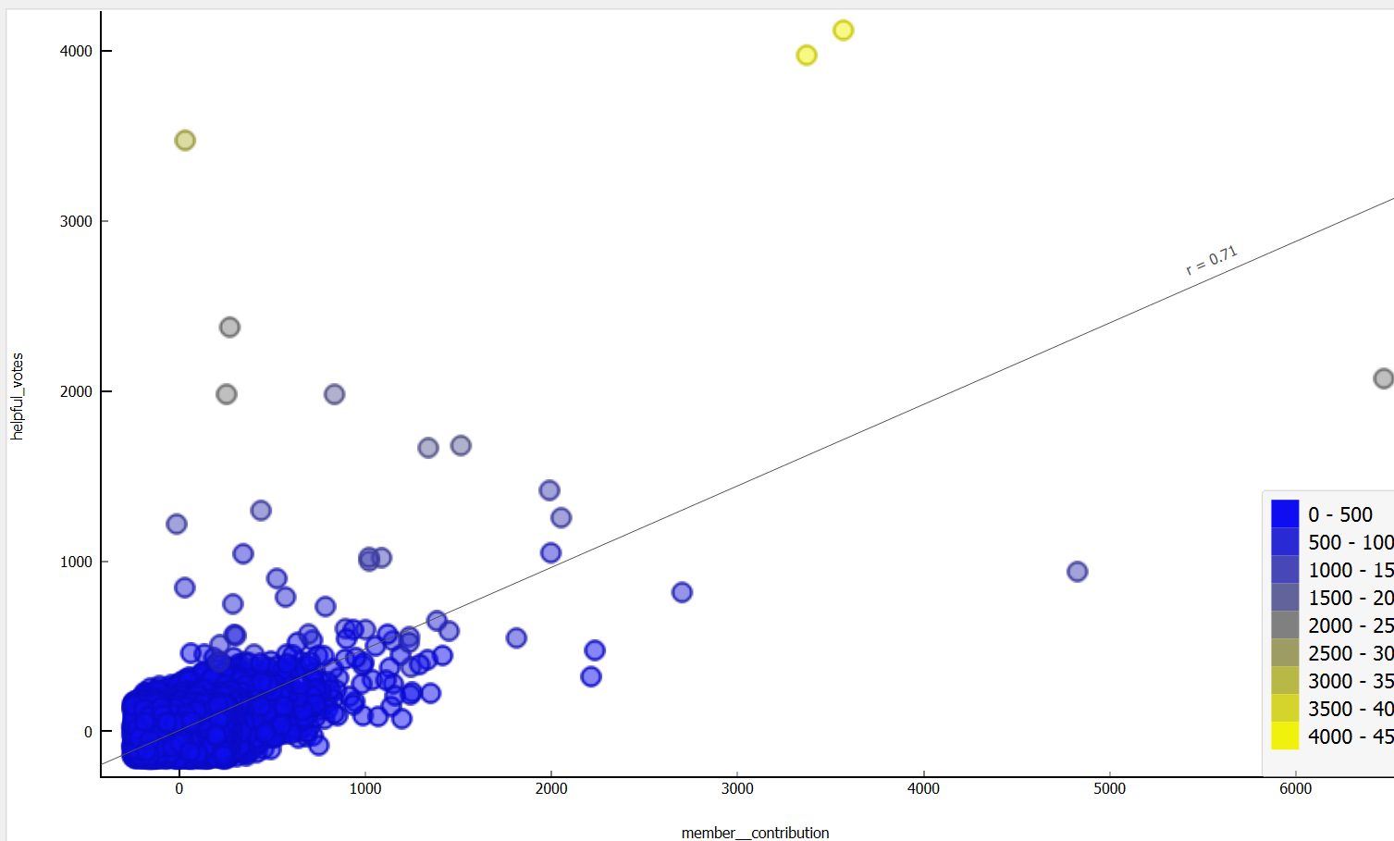
BUSINESS INSIGHTS
Identify and Reward Lead Users
Sharp decline of TA new users in 2018. Attract new users by providing new features like Elite in Yelp.
Correlation between contributions and helpful votes
Encourage every user to contribute not just frequent travellers
4

Slide 5
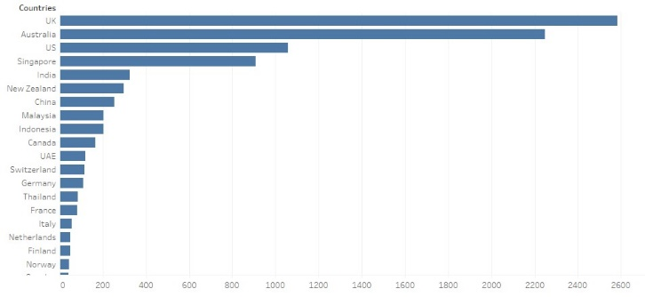
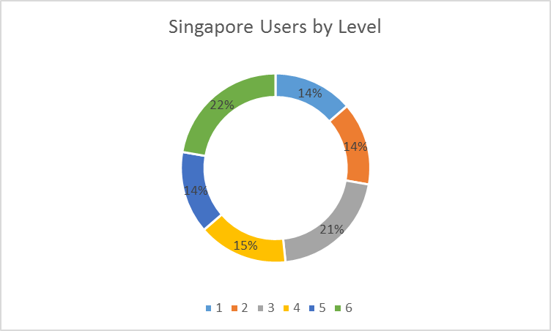
EXPLORATORY DATA ANALYSIS
Most of them from UK, Australia, US, and Singapore. Hotels can win the customers by providing facilities famous among citizens of these countries.
The majority of Singaporean users were experienced reviewers.
5

Slide 6
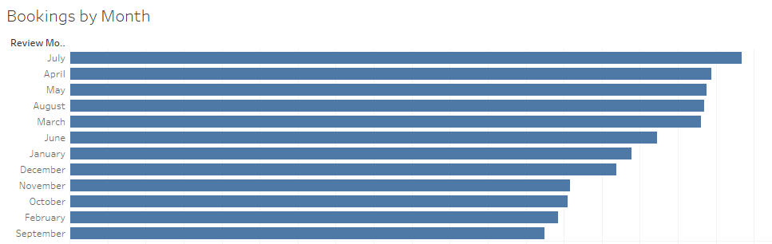
EXPLORATORY DATA ANALYSIS
Hotel Bookings are in peak in July and surprisingly not in December.
In Oct, Nov, Feb and Sep the bookings drop by 30 %. Hotels can provide promotions during this month to attract customers.

Slide 7
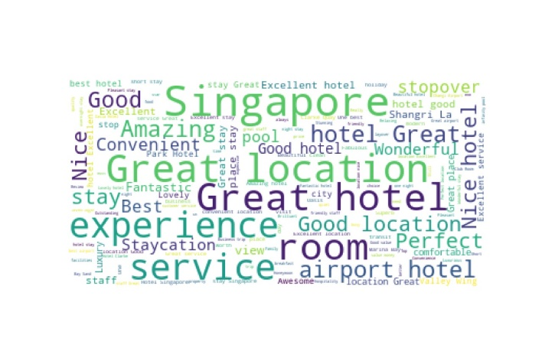
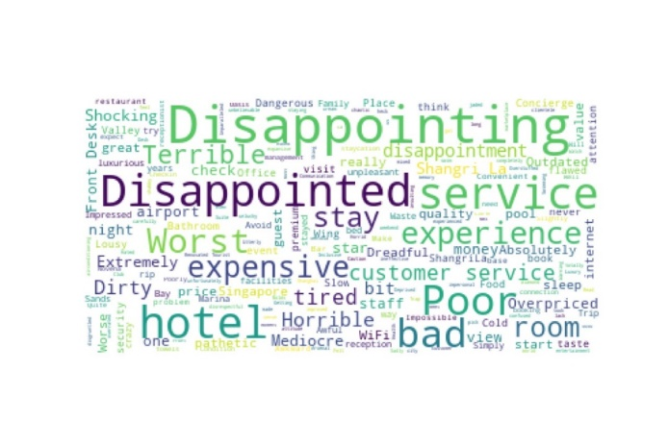
SENTIMENT ANALYSIS
Average rating of each of the hotels was 4.38 out of 5
Park Hotel received more positive feedback.
Shangri la hotel has more higher ratings.
7

Slide 8

Time for Qns
THANK YOU

